Slide 1
Lecture 13 Second-order Circuits (1)
Hung-yi Lee

Slide 2
Second-order Circuits
A second order-circuit contains two independent energy-storage elements (capacitors and inductors).
Capacitor + inductor
2 Capacitors
2 inductors
Notes:
irreducible

Slide 3
Second-order Circuits
Steps for solving by differential equation (Chapter 9.3, 9.4)
1. List the differential equation (Chapter 9.3)
2. Find natural response (Chapter 9.3)
There is some unknown variables in the natural response.
3. Find forced response (Chapter 9.4)
4. Find initial conditions (Chapter 9.4)
5. Complete response = natural response + forced response (Chapter 9.4)
Find the unknown variables in the natural response by the initial conditions

Slide 4
Solving by differential equation Step 1: List Differential Equation

Slide 5
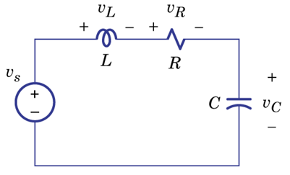
Systematic Analysis
Mesh Analysis
Notes:
What is known? What is unknown?

Slide 6
Systematic Analysis
Mesh Analysis
Find v_{C}:
Find i_{L}:

Slide 7
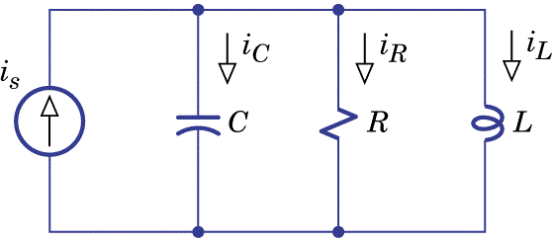
Systematic Analysis
Node Analysis

Slide 8
Systematic Analysis
Systematic Analysis
Node Analysis
Find i_{L}:
Find v_{C}:
v_{C}=v

Slide 9
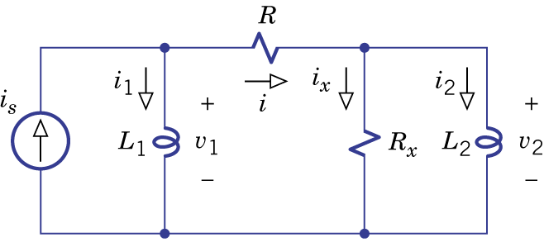
Example 9.6
v₁
v₂
Find i₂
v₁:
v₂:

Slide 10
Example 9.6
v₁
v₂
Find i₂
Target:
Find v₂ from the left equations
Equations for v₁ and v₂
Then we can find i₂

Slide 11
Example 9.6
v₁
v₂
Find i₂
Find v₂

Slide 12
Example 9.6
v₁
v₂
Find i₂
Replace
with

Slide 13
Example 9.7
Please refer to the appendix

Slide 14
Summary – List Differential Equations

Slide 15
Solving by differential equation Step 2: Find Natural Response

Slide 16
Natural Response
The differential equation of the second-order circuits:
y(t): current or voltage of an element
α = damping coefficient
ω₀ = resonant frequency
Notes:
Related to the elements
f(t): Related to the sources
e.g. derivative of the current or voltage of the sources

Slide 17
Natural Response
The differential equation of the second-order circuits:
Focus on y_{N}(t) in this lecture

Slide 18
Natural Response
y_{N}(t) looks like:
Characteristic equation

Slide 19
Natural Response
Overdamped
Real
Critical damped
λ₁, λ₂ is
Underdamped
Complex
Undamped

Slide 20
Solving by differential equation Step 2: Find Natural Response
Overdamped Response

Slide 21
Overdamped Response
λ₁, λ₂ are both real numbers
y_{N}(t) looks like

Slide 22
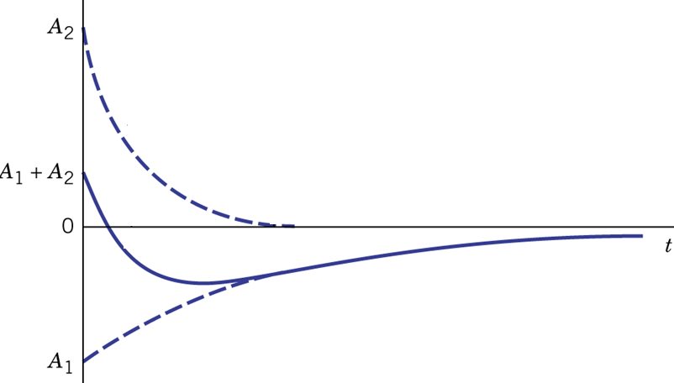
Overdamped Response
Notes:
Always decrease?
It does not have oscillation

Slide 23
Solving by differential equation Step 2: Find Natural Response
Underdamped Response

Slide 24
Underdamped
Notes:
Why use j instead of i?

Slide 25
Underdamped
Euler's formula:
y_{N}(t) should be real.
Notes:
Euler's formula: Taylor series
A₁ and A₂ do not have to be real!

Slide 26
Underdamped
Euler's formula:
(no real part)
y_{N}(t) should be real.

Slide 27
Underdamped
a and b will be determined by initial conditions
Memorize this!

Slide 28
Underdamped
L and θ will be determined by initial conditions

Slide 29
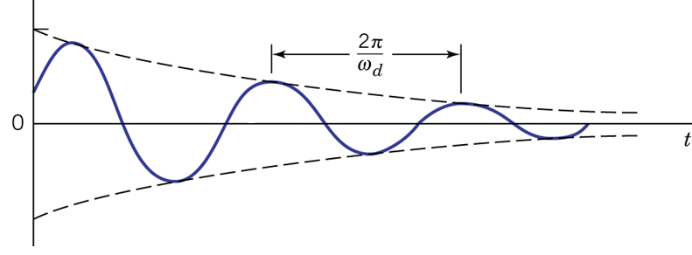
Underdamped

Slide 30
Solving by differential equation Step 2: Find Natural Response
Undamped Response

Slide 31
Undamped
Undamped is a special case of underdamped.

Slide 32
Solving by differential equation Step 2: Find Natural Response
Critical Damped Response

Slide 33
Critical Damped
Overdamped
Underdamped
Critical damped
Not complete

Slide 34
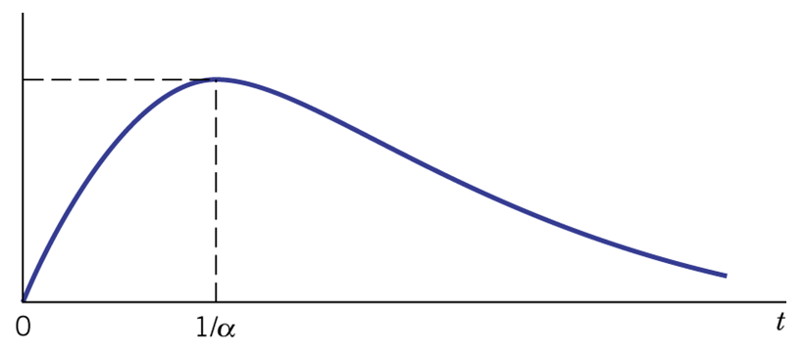
Critical Damped (Problem 9.44)

Slide 35
Solving by differential equation Step 2: Find Natural Response
Summary

Slide 36
Summary
Fix ω₀, decrease α (α is positive):
Critical damped
Underdamped
Undamped
Overdamped
Decrease α, smaller R
Decrease α, increase R

Slide 37
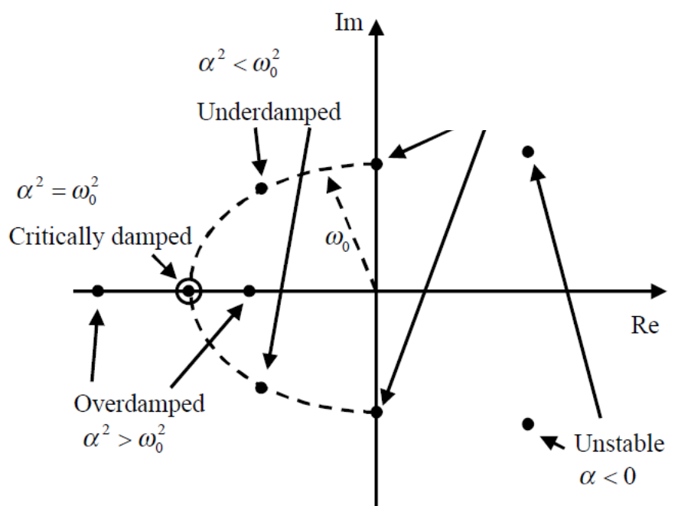
Fix ω₀, decrease α (α is positive)
The position of the two roots λ₁ and λ₂.
α=0
Undamped

Slide 38
Homework
9.30
9.33
9.36
9.38

Slide 39
Thank You!
Notes:
http://www.sml.ee.upatras.gr/uploadedfiles/stateformulation.pdf

Slide 40
Answer
9.30: v1’’ + 3 v1’ + 10 v1 = 0
9.33: yN=a e^(-0.5t) + b te^(-0.5t)
9.36: yN=a e^(4t) + b e(-6t)
9.38: yN=2Ae^(3t) cos (6t+θ) or yN=2e^(3t) (acos6t + bsin6t)
In 33, 36 and 38, we are not able to know the values of the unknown variables.

Slide 41
Appendix: Example 9.7

Slide 42
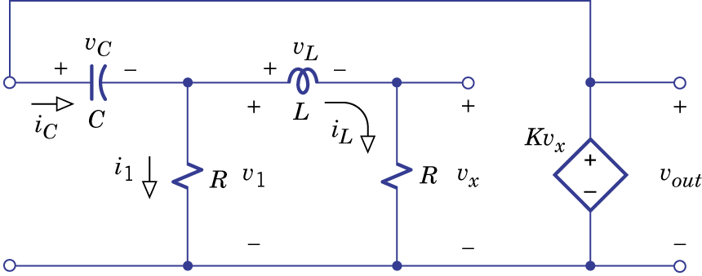
Example 9.7
Mesh current: i₁ and i_{c}

Slide 43
Example 9.7
(1):
(2):
(2) – (1):

Slide 44
Example 9.7

Slide 45
Appendix: Figures from Other Textbooks

Slide 47
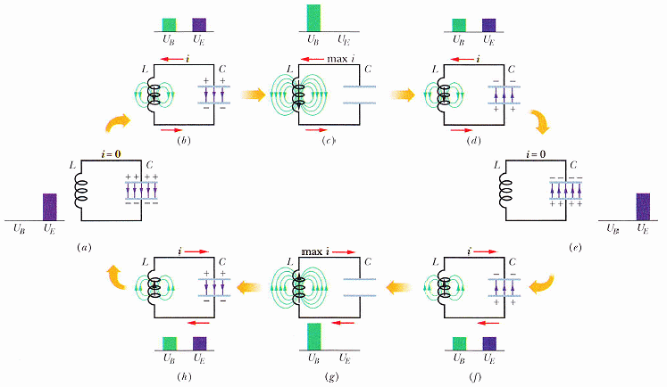
Undamped

Slide 48
Acknowledgement
感謝 陳尚甫(b02)
指出投影片中 Equation 的錯誤
感謝 吳東運(b02)
指出投影片中 Equation 的錯誤

